Slide 1
UI Design

Slide 2
The UI Design Process
Define a set of representative user types.
Identify the most important activities i.e. use cases.
Assume some user model based on how you think each user will expect to accomplish each activity
Design the UI based on the current user model
use metaphors to illuminate the user model
borrow familiar behaviours from other programs especially controls
keep it very simple, users will always assume the simplest model
Implement a prototype.
Test each use case with each user type and iterate.
Note areas where people have trouble. These are probably areas where the program model does not match the user model.
Refine the user model and iterate from 4

Slide 3
User Types
User types (stakeholders) are often application specific but can commonly be placed into skill categories:
techies - enjoy figuring out how things work
experienced users - think they already know how everything works
naïve users - often too timid to explore the interface
There is also an increasing dichotomy between
digital natives - children raised in the internet age
digital immigrants - non-natives trying to use computers

Slide 4
User Types
What are the user’s goals?
What are the user’s skills and experience?

Slide 5
Use Cases
A use case describes a typical user activity from start to end.
A good set of use cases motivates a design, and provides a basis for testing.
A use case will consist of
Definition of the user’s goal
List of pre-conditions (e.g. information needed before the task can start)
Criteria for successful completion
List of main steps in the activity flow
Any extensions/alternatives to this use case

Slide 6
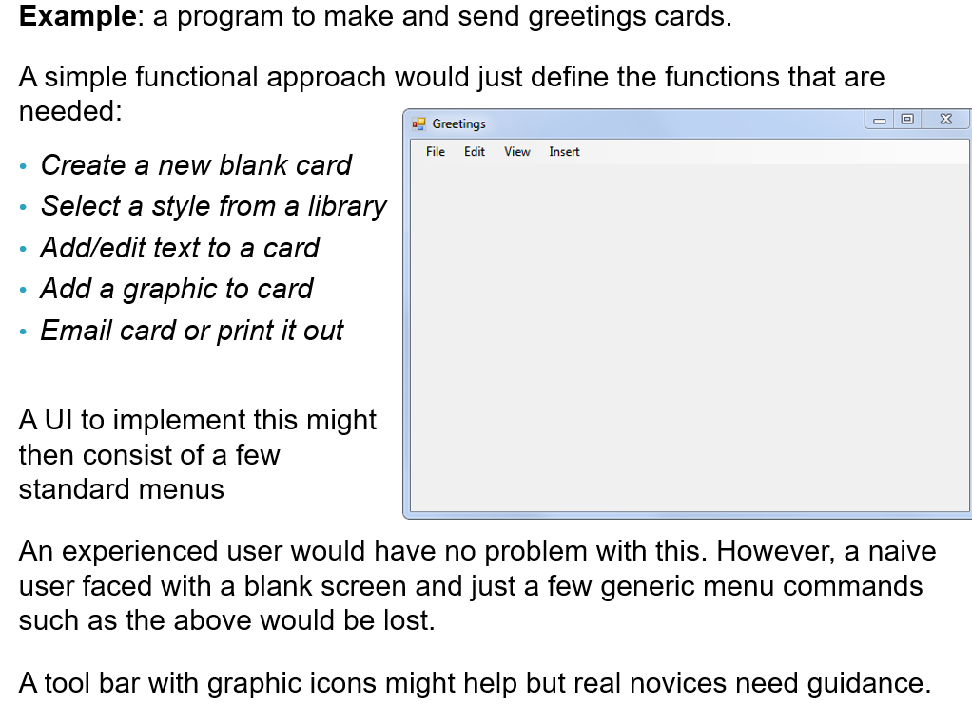

Slide 7
Wizards
Wizards guide a user through pre-stored use cases one step at a time.
Example: continuing the greeting card example, the Wizard would lead the user through a sequence of steps:
Step 1 What do you want to do?
User chooses (1)
1. Send a birthday card?
2. Send an anniversary card?
3. Send a party invitation?
4. Start with a blank card?

Slide 8
Wizards
Step 2 Select a background:
Step 3 Enter desired greeting:
Etc.
User selects from a palette of birthday card designs
User types greeting into a text box

Slide 9
User Model
User model is the user’s mental model of what is happening.
Note that different users will have different mental models. A good UI design encourages every user to adopt the same mental model.

Slide 10
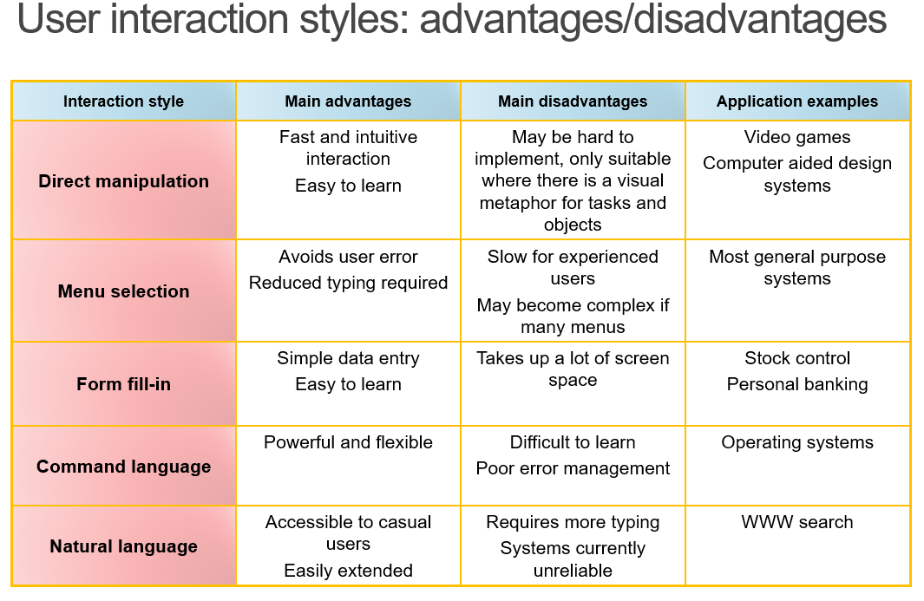

Slide 11
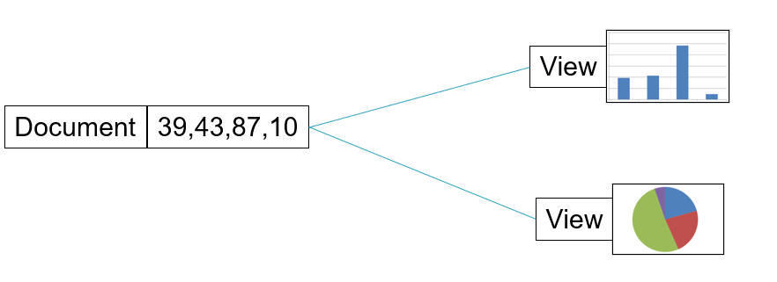
Information Presentation
All interactive systems need some way of presenting information to the user. It is a good design practice to keep the presentation separate from the information itself

Slide 12
Colour Interface Design
Almost all interactive systems today support colour displays and so the GUI should make (careful) use of colours
Colour can:
simply be a tool to provide highlighting
may improve the GUI by helping the user understand the data presented and by managing its complexity
Misuse of colour may:
result in a GUI that is visually unattractive
may lead to mistakes by the user

Slide 13
Colour Interface Design
The general rule for GUI designers is to be conservative in the use of colour in displays
The two most common errors made by designers when using colour in a GUI are
Associating meaning with a particular colour
Using too many colours
Why not use colour for meaning?
Around 1 in 12 men and 1 in 200 women are colour blind – as a result they may misinterpret the meaning of the colour
User confusion is also possible if colours are used inconsistently
If too many colours are used, or the colours are bright, the display may disturb the user and cause visual fatigue

Slide 14
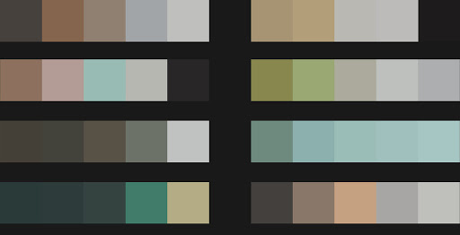
Guidelines for Colour
1. Limit the number of colours used and be conservative in how they are used
Don’t use more than four or five separate colours in a window and no more than seven in a system (roughly)
Colours should be used selectively and consistently

Slide 15

Guidelines for Colour
Use colour change to show a change in system status
If a display changes colour, this should mean that a significant event has occurred
Colour highlighting is particularly important in complex systems where hundreds of distinct entities may be displayed e.g. trading floor systems

Slide 16
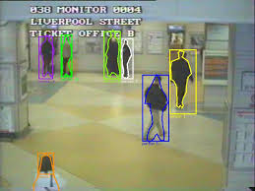
Guidelines for Colour
Use colour coding to support the task which users are trying to perform
If they are attempting to identify anomalous instances, highlight these instances

Slide 17
Guidelines for Colour
Be careful about colour pairings
Red combined with blue can lead unintentionally to a 3D effect - chromostereopsis
Because of the physiology of the eye, people cannot focus on red and blue together

Slide 18
Most people see the red
Closer than the blue,
But some see the
opposite effect

Slide 19
Guidelines for Colour
Use colour coding in a thoughtful and consistent way
If one part of a system displays error messages in red then all other parts should follow
In such a case red should not be used for anything else on the system – only error messages
Therefore, if a user sees red, they may interpret it as an error message
Be aware of the user’s assumptions about particular colours

Slide 20
Error Messages
Error messages should be there to help the user.
They should be
polite
concise
consistent
constructive
appropriate to user’s skill level

Slide 21
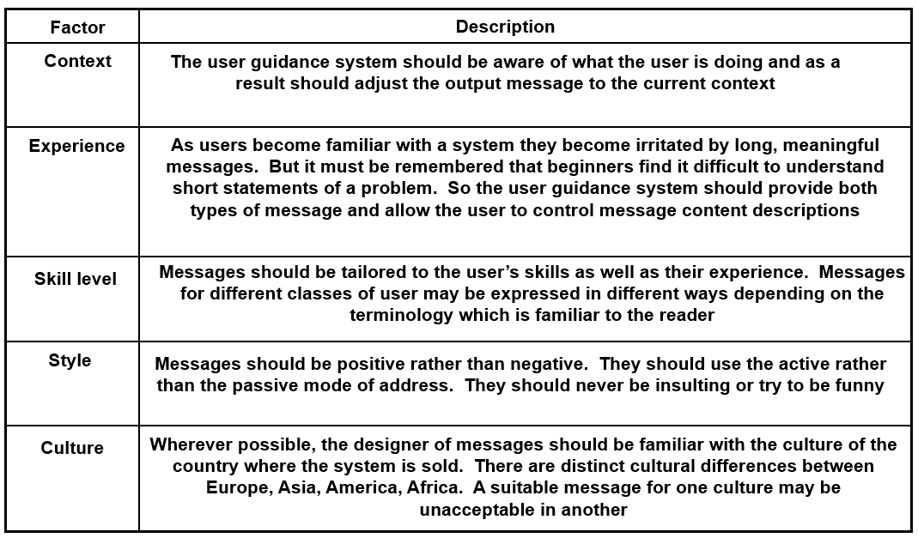
Error Message Design Factors

Slide 22
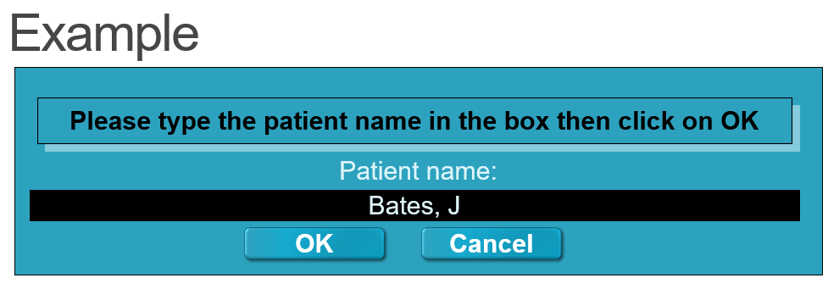
Say that the patient was actually called ‘Bales’, rather than the input name ‘Bates’ and as a result the system did not recognise the name
The system would therefore have to generate an error message advising the user that the information entered was incorrect

Slide 23
System Orientated Error
Error 27
Invalid patient id entered
OK
Cancel
The example of the system-oriented message is badly designed
It is negative, as it accuses the user of making an error
It does not take into account the user’s skills or take context information into account
It does not suggest how the situation may be resolved
It uses system-specific terms (patient-id) rather than user-oriented language (patient’s surname)
Somewhere, an explanation for error 27 must exist: why else would the designer have added such information to the message?

Slide 24
User-Oriented Error Message
Patient J. Bates is not registered
Click on Patients for a list of registered patients in ICU
Click on Retry to re-input a patient name
Click on Help for more information
Patients
Help
Retry
Cancel
The user-oriented error message is better:
It is positive: it does not imply that the problem is user-oriented
It identifies the problem in the nurse’s terms
It offers an easy way to correct the error
A help system is available

Slide 25
Metaphors
Using a metaphor can help a user align their mental model with the way that the program actually works.
The classic example is the ubiquitous “desktop” used in nearly all popular operating system interfaces.
A good metaphor is
Extendible
helps user infer how to do new things
General
applies to whole program, not just one bit of it
Necessary
if the software is obvious to users, do not introduce gratuitous metaphors.
Beware of cultural boundaries

Slide 26
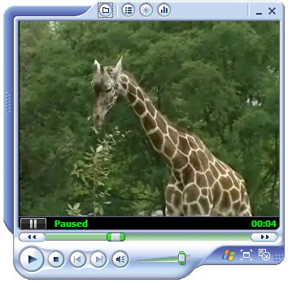

Examples

Slide 27
UI Testing
Interface evaluation is the process of assessing the usability of an interface and checking that it meets the requirements. These are often linked to the non-functional requirements of a project. A user interface specification may include:
Learnability (time taken to learn)
Speed of operation
Robustness (tolerance to user error)
Recoverability (how well it recovers from errors)
Adaptability (can it be used in different ways?)
These should ideally be measurable

Slide 28
Summary
The key ingredient to a successful UI is to ensure that the user adopts a mental model which is consistent with the underlying program model
To achieve this a compromise is needed
use metaphors, wizards, etc., to guide the user to the right model
modify the program model to match user expectations
Consistency is very important
Take care with use of colour
Use cases help with UI design and guide testing

